Slide 1
Data Science
Salary Forecaster
Rich Kirschenheiter, Stefany Lima, Timothy Kelley, Sabyasachi Das, James Bruning, & Arielle Eagan

Slide 2
As future Data Science and STEM professionals, graduates of the NU Data Science Bootcamp are curious about the job market and earning potential in new roles available after the Bootcamp….

Slide 3
And for those roles,
what salaries can we ask for?

Slide 4
As an applicant, salary negotiations are daunting.
No one wants to go into negotiations without a sense of what others are being paid and what they can ask for.

Slide 5
So, we created a
Data Science Salary Forecaster

Slide 6
We started with our existing interactive online tool, which maps Data Science salaries across 5 leading companies.

Slide 7
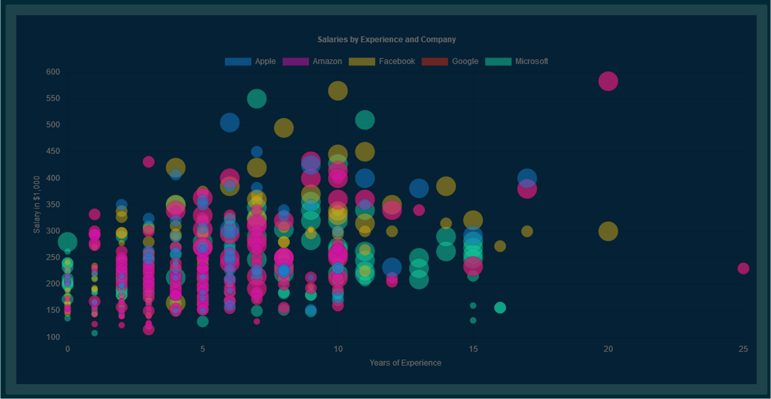

Slide 8
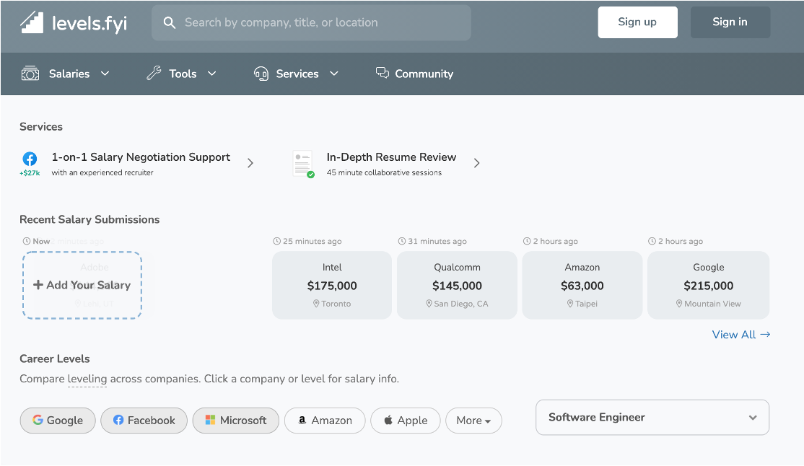
Data source of our interactive tool:
Data scraped from a site called levels.fyi : https://www.levels.fyi/?compare=Google,Facebook,Microsoft&track=Software%20Engineer
API in JSON format allowed us to pull more updated data, running only about 6 days behind current present day.
Data set included:
company name
job title, location (city and state)
compensation
total yearly compensation
base salary
bonus
stock grants
demographics

Slide 9
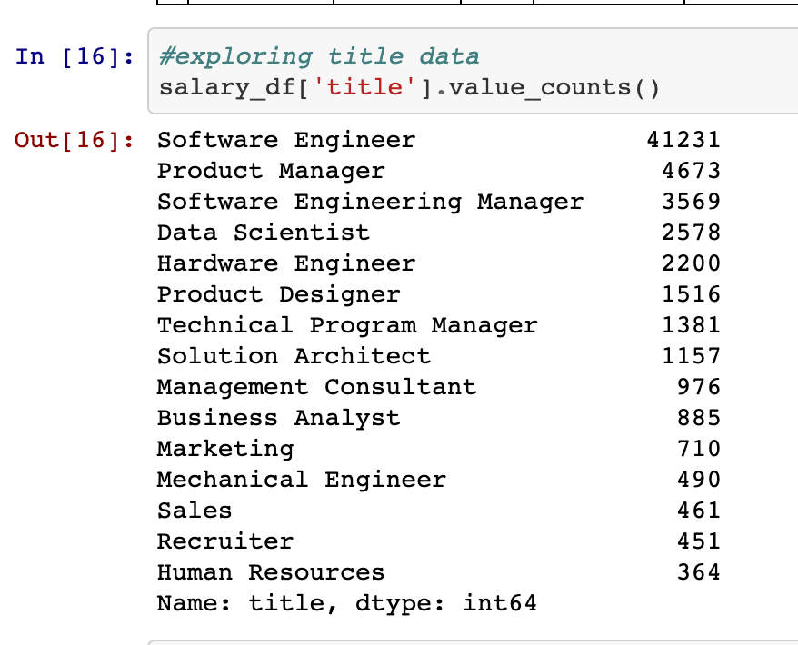
Original data cleaning process for our interactive tool:
Steps we took to clean the data:
Analyzed data first
Dropped non-relevant columns (ex: kept city name but dropped ”cityID”
Began to analyze salary data
Began to analyze different companies
Began to interpret “levels” of roles at each company
Created bins for “entry”, “mid”, and “senior” levels

Slide 10
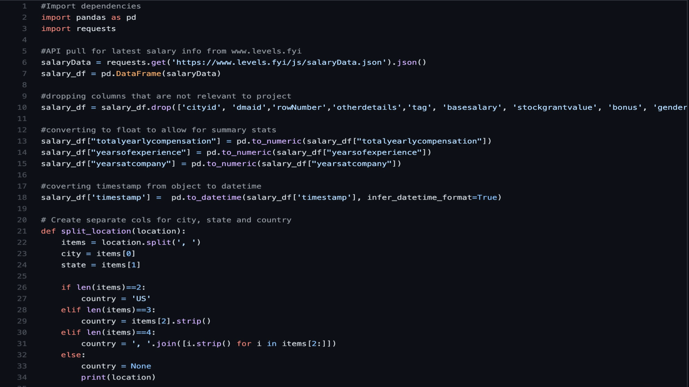
Original python script for interactive tool

Slide 11
We used Chart.js library to create our
interactive tool

Slide 12
Building off of this interactive tool, we created a machine learning predictive model to predict Data Science salaries.

Slide 13
Steps
Lorem 2
Lorem 3
Lorem 4
Lorem 5
Cleaning
Feature
Engineering
Model Selection
Hyperparameter Tuning
Final Model / Demo
Lorem 1
Reduce noise by converting levels to numeric values, resolved null value issues, and mismatched formatting.
Determined what features to use. Started with five but our absolute mean error was too high to be useable. Added two more features which dramatically improved our model’s accuracy.
Deciding which models, Neural Net or Random Forest, best suit our data.
Running models multiple times to find best results with the best parameters possible, using .
Combining original features and predicted features as inputs into final model for prediction. Final model demo.

Slide 14
Data Cleaning
Even though data had already been cleaned, we went through it once again to make it accessible to models used later on.
Notes:
Data cleaning (Stefany)

Slide 15
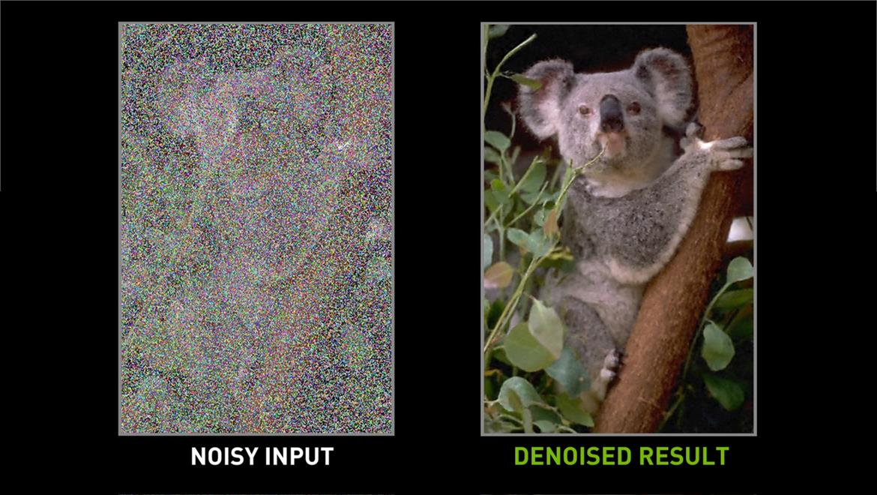
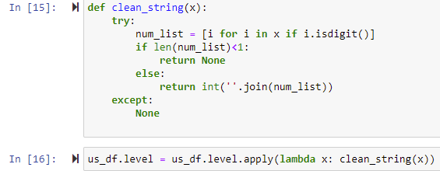
Focus on reducing noise
In contrast to our original project, where we only used data from the top 5 companies, we expanded to include all companies in dataset.
Removed blank spaces and capitalization
Assigned level numbers across companies for similar jobs

Slide 16
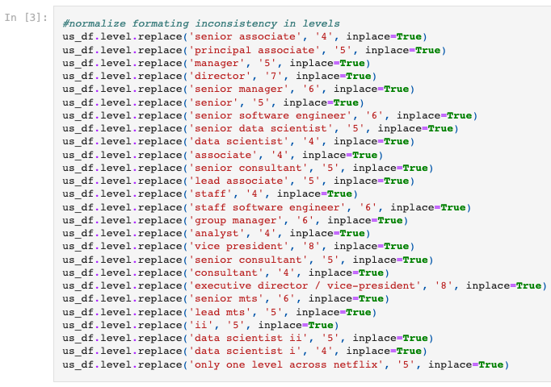
Reduced noise in the levels data by as much data as we could to a numeric value.
In future iterations, we would benefit from a domain expert to confirm numeric levels assigned are proportionate to job title.

Slide 17
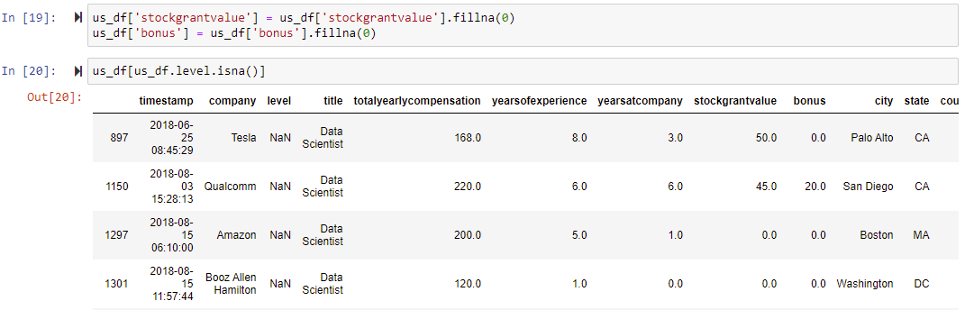
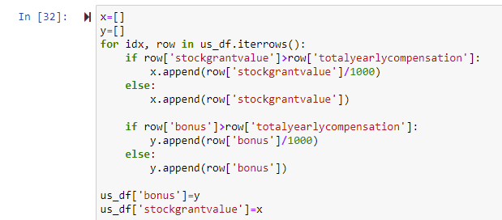
Replaced missing values with 0.
Dropped NaN levels that didn't fit our cleaning loop.
Corrected inconsistent data formatting.

Slide 18
Feature Selection

Slide 19

We had a variety of avenues we could try and approach with our feature selection
Location
Company specific
Experience
Country of Origin
Title

Slide 20
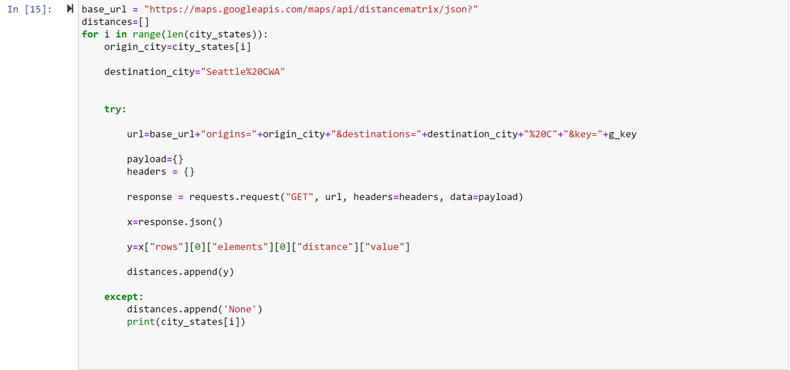

6 Main Features
Years at company
Years of experience
Level at company
Distance from 3 major cities
Bonus
Equity

Slide 21



We decided to focus on
3 major cities
for Data Science jobs in the US.
Seattle, WA
New York City, NY
San Francisco, CA

Slide 22
Model Selection
and Structure

Slide 23


First Step: Trial and Error
Random Forest
MLP Regressor
Notes:
First step: Trial and Error
<two clicks>MLP Regressor and
<two more clicks> Random Forest <click>

Slide 24
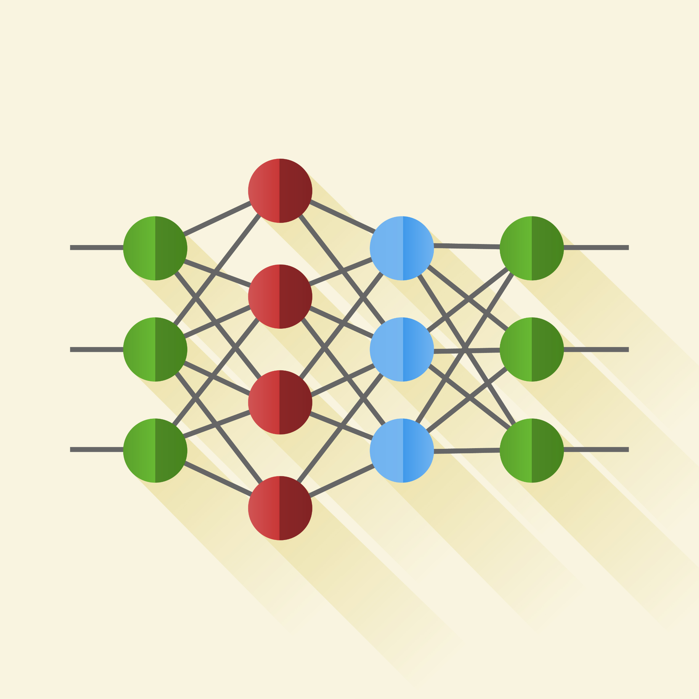
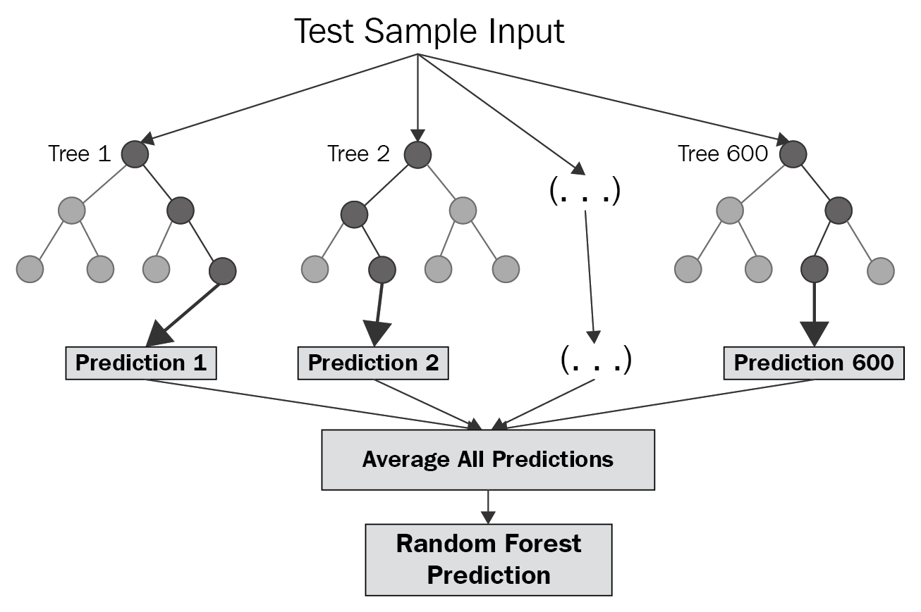
First Step: Trial and Error
MLP Regressor
Random Forest
Notes:
We started with just the five of the features that we either could ask the user for (where is the job, how much experience do you have, etc), or that could be assumed depending on how the tool was set up (no years at company, for example, for those looking for a new job at a new company). We used those features to train a basic neural net model using MLPRegressor and a Random Forest model. Rich will discuss in a minute in more detail what the actual modelling and fit process looked like, but pretty consistently we found that the MLPRegressor was getting the lowest mean absolute error, so we focused in on that.

Slide 25
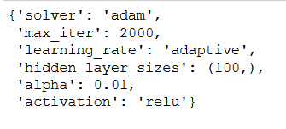
Variables
MLPRegressor:
hidden_layer_sizes
activation
solver
alpha
learning_rate
Random Forest:
max_depth
min_samples_leaf
Notes:
With the guidance of our erudite and lettered subject matter expert, and her insightful and scholarly assistant, we selected a number of variables for each model that we could tune, and utilized a Randomized Search to select the best configuration for these.

Slide 26
Second Step: Adding Predictions
(and features)
Original model:
Would take in 3-4 data points
Job Level
Job Location
Years of Experience
Years at Company (optional)
Would return a total yearly compensation
Potential upgraded model:
Would take in same 3-4 features
Level, Location, Experience and Seniority
Would return a total yearly compensation, and expectations for bonuses and equity or stock options.
Notes:
Along about this time, it was suggested that we consider adding back in two of the additional features that could also be predicted as part of the tool - bonuses and equity (stock options). This would, of course, be unknown by the user (since predicting that is the point of the tool), but it was data that was collected as part of the dataset we were using.
<click> So the original model was planned to take in three to four data points, and return a predicted total yearly compensation.
<click>And the proposed upgraded model would take in the same three or four data points and return the predicted total yearly compensation and a predicted bonus and equity/stock option.
To accomplish this, we trained three models each - two using the original 3-4 data points (which relate to six features) to predict expected bonus and equity/stock options, and one that also included the bonus and equity data to predict a total yearly compensation. Our interactive predictor would then be able to take in our available data, predict [and return] both a bonus and an equity, and use those data points to predict total yearly compensation. Adding in those two features improved the accuracy of our final total yearly compensation pretty drastically. (MAE of 60-something-thousand down to 20-something-thousand).
We also considered utilizing a binary for bonuses and equity of whether or not a position could expect to receive one or the other (or both), but really felt drawn to see if the model could be trained to return all three data points.

Slide 27

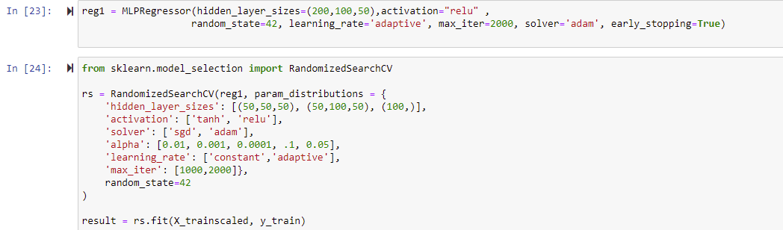
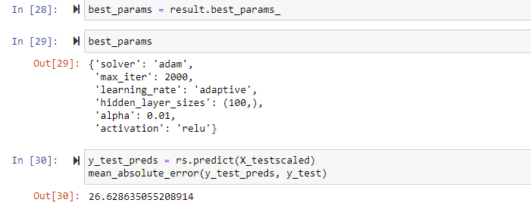
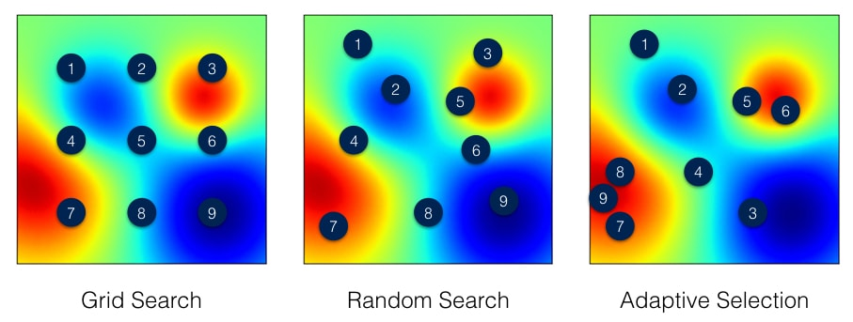
Hyper-Parameters Tuning:
We used Randomized Search CV to determine the best parameters for our model in order to have the lowest possible mean absolute error for each model.

Slide 28
Neural Network Models Built
Features:
Years at Company
Years of Experience
Level
Distance of Job location from NYC
Distance of Job location from SF
Distance of Job location from Seattle
model
Total Yearly Compensation
bonus_model
Bonus
equity_model
Equity
Model Accuracy (calculated in terms of Mean Absolute Error)
Model for | Baseline Error of Means for Model | MAE with Random Forest | MAE with Neural Network | MAE with Neural Network and hyperparameter tuning
Total Yearly Compensation | 75.23 | 37.46 | 27.06 | 26.63
Bonus | 69.01 |  | 11.70 | 11.31
Equity | 594.50 |  | 39.39 | 38.25
Notes:
live demo - function created, saving of models and scalers, accuracy of model predictions, actual presentation of tool (Sabyasasachi)

Slide 29
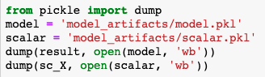
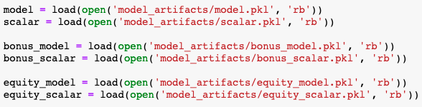
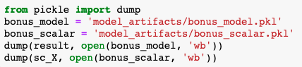
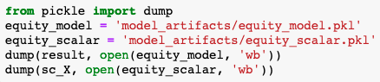
Saving the models and the scalars
Loading the trained models and the scalars into the final prediction notebook
The models can now be used to predict total yearly compensation, bonus and equity for a set of user inputs

Slide 30
Saved Neural Network
Model & Scalar for EQUITY
Predicted
EQUITY
User Inputs:
Years at Company
Years of Experience
Level
Saved Neural Network
Model & Scalar for
TOTAL YEARLY COMPENSATION
Final Prediction Function
Distance Function
Distance from NY
Distance from SF
Distance from Seattle
User Input:
Job Location
Yearly Compensation
Bonus
Equity
Saved Neural Network
Model & Scalar for BONUS
Predicted
BONUS

Slide 31
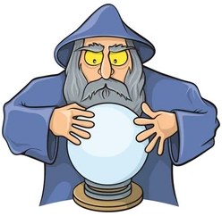
Ready for some predictions?

Slide 32
Conclusion

Slide 33
Limitations, lessons learned, and next steps
Limitations:
Data seems to have been collected via a survey with write-in sections, which allowed people to fill in data points themselves. A survey with drop-down options would have helped input data more cleanly and would have helped us feel more confident in our binning of entry, mid, and senior level positions at companies.
Own our skills - we’re still learning!
Lessons learned:
Involve experts in the content area to ensure that data represents the truth accurately
Ex: have experts in content area on team, conduct focus groups, conduct market research
Work as a team - it’s helps encourage creativity, encouragement, and to catch errors in code
We are gaining valuable (literally $$) skills in this Data Science Bootcamp
Next steps:
Continued testing of the model
Using the model to help us negotiate our own future jobs! We hope you use it too :)

Slide 34
Thank you for our instructional team for their support in this project!

